Slide 1
Capstone Project: Building a Public Park in Toronto
Wilson
May 31st, 2019

Slide 2
Introduction / Business Problem
Major cities with dense population such as Toronto often lack public areas designated for outdoor leisure. This project will use Foursquare API to understand at a high level the infrastructures of Toronto and determine an ideal location to build a public park.

Slide 3

Data
The Wikipedia page used in week 3 of this course contains a list of neighborhoods and establishments in Toronto.
Web scraping techniques were used to extract the data from the web page using various packages from Python.
Then geographic coordinates of the different locations will be acquired using Python Geocoder package.
Lastly, Foursquare API will be used to get the detailed venue data to determine an ideal location for a new park.
Data Required:
List of neighborhoods in Toronto
Geographic coordinates and map of Toronto
Venue data from Foursquare

Slide 4
Methodology
Web scraping via Python beautifulsoup package was used to gather a list of neighborhoods in Toronto
Subsequently, Geocoder package was used to acquire latitude and longitude of the locations from web scrapping
Data wrangling was performed to clean and manipulate the data, and then to populate them into Pandas dataframe
Folium package was used to map the locations and thus verify that the correct dataset was gathered for the analysis
Foursquare API
k-means clustering

Slide 5
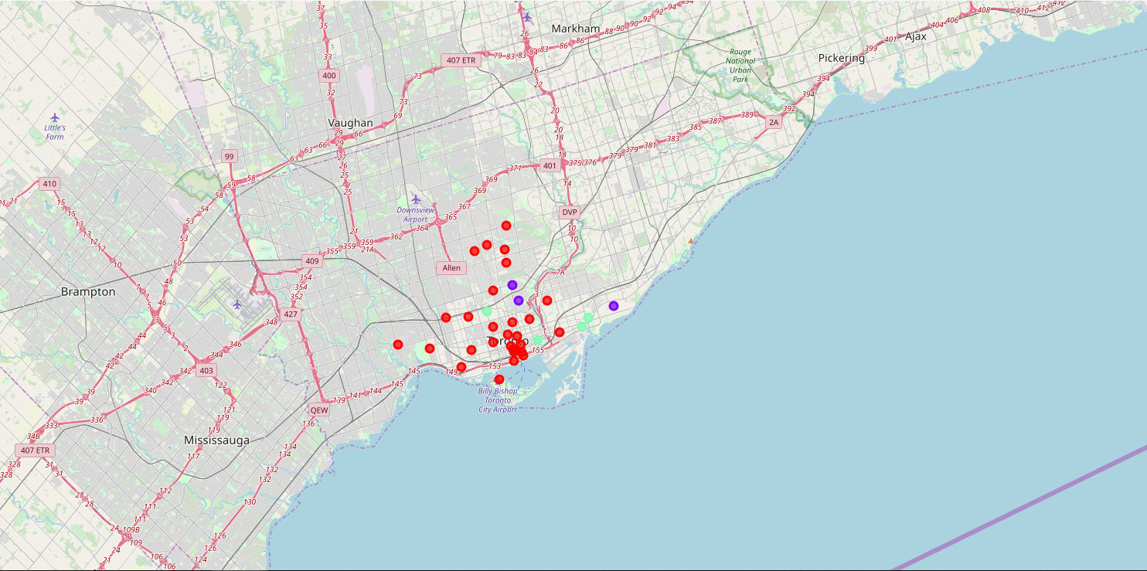
Results
Three clusters were created. Red being Cluster 0, blue being Cluster 1, and green being Cluster 3. Cluster 1 has many (relatively) while cluster 2 has moderate number of parks. Cluster 0 on the other hand has little to no parks. Cluster 0 also has the most neighborhoods.

Slide 6
Conclusion
In this Capstone project, business problem was identified, data requirement was specified, data wrangling was performed, and machine learning by clustering was performed. The conclusion to the business question raised in the introduction section is the following: The neighborhoods in cluster 0 have little to no public parks and thus the most preferred locations to open one. The conclusion can be used by stakeholders to improve public infrastructure in Toronto.

